Slide 1

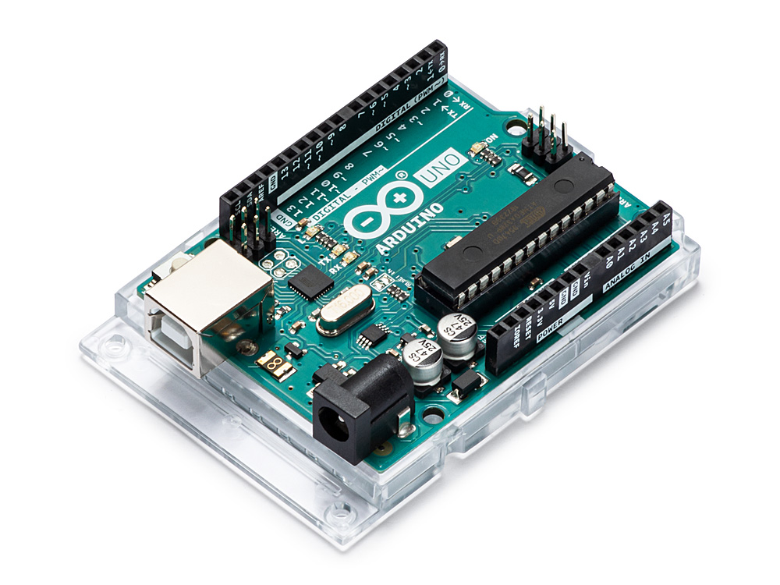
ECE661:ARDUINO

Slide 2
LTP and credit details
LTP – 3 0 2
Total Credits - 4

Slide 3

Revised Bloom’s Taxonomy

Slide 4
Course Outcomes
CO1 :: understand basics of microprocessors and microcontrollers
CO2 :: define the basics elements of Arduino development board
CO3 :: apply basic knowledge of programming and Arduino for serial communication
CO4 :: develop various basic modules by interfacing different peripherals with Arduino
CO5 :: analyze the various communication protocols supported by Arduino
CO6 :: integrate the different external devices for creating real world applications

Slide 5
POs Relevant to Course
PO1 | Engineering knowledge: Apply the knowledge of mathematics, science, engineering fundamentals, and an engineering specialization to the solution of complex engineering problems.
PO3 | Design/development of solutions: Design solutions for complex engineering problems and design system components or processes that meet the specified needs with appropriate consideration for the public health and safety, and the cultural, societal, and environmental considerations.
PO5 | Modern tool usage: Create, select, and apply appropriate techniques, resources, and modern engineering and IT tools including prediction and modeling to complex engineering activities with an understanding of the limitations
PO7 | Environment and sustainability: Understand the impact of the professional engineering solutions in societal and environmental contexts, and demonstrate the knowledge of, and need for sustainable development.
PO9 | Individual and team work: Function effectively as an individual, and as a member or leader in diverse teams, and in multidisciplinary settings.
PO10 | Communication: Communicate effectively on complex engineering activities with the engineering community and with society at large, such as, being able to comprehend and write effective reports and design documentation, make effective presentations, and give and receive clear instructions.
PO11 | Project management and finance: Demonstrate knowledge and understanding of the engineering and management principles and apply these to one’s own work, as a member and leader in a team, to manage projects and in multidisciplinary environments.

Slide 6
Syllabus
Unit I Introduction to Arduino Platform : Arduino as open source platform, Types of Arduino boards, Arduino UNO board details, Introduction to Arduino IDE, Structure of Arduino sketch, Uploading the code to Arduino UNO Serial Communication as debugging tool : Initialization of Arduino UNO serial port, Sending data to Arduino UNO via serial port, Receiving data from Arduino UNO via serial port, Reading switch status with Arduino UNO serial port
Unit II Programming internal peripherals of Arduino UNO : Specifications of internal ADC, Programming internal ADC, Programming of Arduino UNO PWM, Controlling Arduino UNO PWM with ADC
Unit III Interfacing output devices : Specifications of 7 – segment, Specifications 16x2 LCD, Introduction to LiquidCrystal library

Slide 7
Syllabus
Unit IV Interfacing actuators : Introduction to DC motor, Introduction to DC motor driver circuit, Speed and direction control of DC motor with Arduino UNO
Unit V Interfacing of sensors : Introduction to DHT11 humidity and temperature senso, Interfacing DHT11 with Arduino UNO, Introduction to Ultrasonic sensor with output on LCD

Slide 8
Syllabus
Unit VI Interfacing communicating module : Introduction to Bluetooth technology, Working with Bluetooth module AT commands, Interfacing Bluetooth with Arduino UNO for data transmission, Controlling Arduino GPIO from phone
Unit VII List of Practicals : Interfacing 7 – segment with Arduino UNO, Interfacing LCD with Arduino UNO, Controlling servo motor with Arduino UNO, Controlling the speed of DC motor with variable resistor using PWM, Interfacing Ultrasonic sensor with Arduino UNO with output on LCD

Slide 9
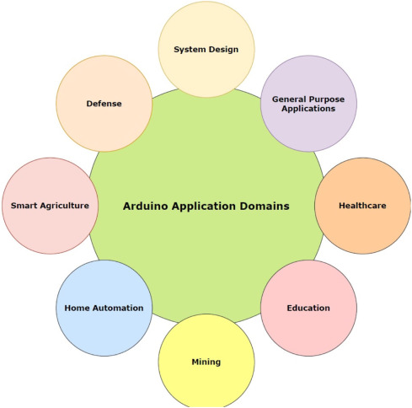
IoT Applications
07/19/22

Slide 10
Course Assessment Model
Marks break up* (May be changed)
Attendance 5
CA (Test and Project): 45
ETE: 100Marks 50
Total 100

Slide 11
Relevant Sources
Sr. No. | Reference Type | Journal Articles as compulsory readings (e-journal, Online Library and Printed Journals/Periodicals)
1 | Relevant Websites | https://www.arduino.cc/en/Guide/Introduction
2 | Relevant Websites | https://www.arduino.cc/reference/en/language/functions/communication/serial/
3 | Relevant Websites | https://roboindia.com/tutorials/seven-segment-nodemcu/

Slide 12
Books
References:
EXPLORING ARDUINO: TOOLS AND TECHNIQUES FOR ENGINEERING WIZARDRY, 2ND EDITION by JEREMY BLUM, WILEY
2. ARDUINO COOKBOOK BY MICHAEL MARGOLIS, O'REILLY by MICHAEL MARGOLIS, O'REILLY

Slide 13


